Slide 1
Programming 4
01.1 Intro to C++ CLI
Semester 2, 2019

Slide 2
Administration
Lecturer: Grayson Orr
Office: D311
Email: grayson.orr@op.ac.nz
Communication Channel: Microsoft Outlook and Teams
Course Material: GitHub
Notes:
I am available nearly 24/7 on all platforms. Don’t hesitate to send me a direct message on Teams or email on Outlook.
I also have an open door policy and happy to discuss anything about the course, etc
Note: I have created a private channel – if you can’t see this, please tell me
The course material will be available on GitHub – I am constantly updating this repository so make sure you git pull each time you come to class
https://github.com/Grayson-Orr/Course-Files/tree/master/Programming%204

Slide 3
Class sessions
Session 1: Wednesday 10am – 12pm in D312
Session 2: Friday 8am – 10am in D105B
Videos will be provided for each session
Notes:
This semester, videos will be provided for each lecture briefly describing the more complicated concepts

Slide 4
Provisional schedule
Week | Date | Session 1 | Session 2
1 | 22-07-2019 | Intro to C++ CLI | Pointers
2 | 29-07-2019 | File Structure | Event Loops
3 | 05-08-2019 | Linked Lists
4 | 12-08-2019 | 2D Animation Algorithms 1 | 2D Animation Algorithms 2
5 | 19-08-2019 | Directional Sprites | Double Buffering
6 | 26-08-2019 | Bound Actions | Dale’s Day and Tile Map
7 | 02-09-2019 | Manual Scrolling Tile Map | Sprite Scrolling Tile Map
8 | 09-09-2019 | NPC Scrolling Tile Map | NPC Collision
9 | 16-09-2019 | Terrain Collision | Assessment (Roguelike) Overview
10 | 23-09-2019 | Inheritance Approach Avoid | Finite State Machines
11 | 14-10-2019 | Intro to Programming Paradigms | Intro to Python
12 | 21-10-2019 | Functional Programming 1 | Functional Programming 2
13 | 28-10-2019 | Logical Programming | Assessment (Language Exploration) Overview
14 | 04-11-2019 | Introduction to Ruby | Introduction to Rust
15 | 11-11-2019 | Assessment Work | Assessment Work
16 | 18-11-2019 | Exam Preparation | Exam

Slide 5
Assessments
Assessment | Weight | Due Date
Practicals | 15% | Weekly
Roguelike | 40% | Friday 25th October 5pm
Language Exploration | 30% | Friday 22nd November 5pm
Exam | 15% | Friday 22nd November
Notes:
Practicals will be due one week from handout – time management is crucial this semester
Roguelike will be a group project (5 weeks)
Language Exploration will be an individual assignment – create Mastermind game with Ruby and Rust (3 weeks)
Exam will cover content taught this semester

Slide 6
Goals
Learn how to design and build increasingly
complex OO architectures
Learn how to use more complex abstract data
types and algorithms
Learn a variety of programming languages and paradigms
Start to think in terms of programming principles,
not technological specifics
Notes:
Up until now, your architectures have been basically: noun = class; verb = method. There are much more elegant ways to group data and computation. With these more complex architectures, come more complicated ways of maintaining communication between classes (e.g data chains). To be able to build large, efficient, scalable applications, you need to start learning these more advanced techniques
In the last three papers, you have mostly used arrays and array lists as your ADTs. To be an average programmer, you need to be able to use these ADTs correctly. To be an excellent programmer, you need to be able to implement them yourself – customise or extend them to a specific problem you want to solve
When we start programming, the logic we write is often a direct translation of our own solution to a problem, into a programming language. This is easiest when you are coming to grips with syntax but results in writing “human-style” algorithms usually producing suboptimal computational efficiency. We want to start thinking about how we can express a problem solution in operations the computer is good at, not operations that a human is good at. Approach every practical with this mindset
We will be covering a wide range of programming languages (Visual C++, Python, Prolog, Ruby and Rust) and programming paradigms (imperative, declarative, functional and logical). For example, although you may not have talked about it, when you are using SQL, you use a completely different paradigm, called “declarative”. In imperative programming, you tell the machine what to do, step by step. In declarative, you just say what you want, and the underlying system works out how to do it. Lots of people are developing in these languages. According to the StackOverflow Developer Survey 2019, C++, Python , Ruby and Rust rank amongst the most popular and most wanted languages. This first half of the semester, we will be learning C++ through game development. This will allow us to explore all the complex architectures, data structures and algorithms we need in order to complete the first assessment. However, the primary goal is to strengthen your programming technique (readability, maintainability, etc), so I will asking you to strive for professional standards
We will be using Visual Studio for our C++ work. Visual Studio has a really good graphics class and its important for what we are doing. When writing C++ programs with VS, you use a specific dialect of C++: Visual C++ or C++/CLI. This is simply Microsoft’s flavour of C++. There are a few minor technical differences between C++/CLI and standard C++, and we will discuss later on
If you did well in Programming 2 and 3, C++ should be straightforward, as both languages are part of the C-Family. The major change is the file structure and learning how to use pointers. This process of changing languages, paradigms and development tools, is one you will go through over and over and over in your career. Be flexible! If you are going to be a dev or devops, you will have to accustom yourself to constant change. The only way to do this is to see a commonality in all the different systems and not get too attached to a single language or tool

Slide 7
Intro to C++ CLI
Brief history
Developed Bjarne Stroustrup
Originally called C with classes
Renamed C++ in 1983
Interchangeable with C
Includes main OO features
Difference between C++ CLI and native C++:
Managed and unmanaged
Managed – compiled to an intermediate format
Unmanaged – compiled to machine exe binary
Automatic garbage collection
Access to the .NET libraries
Notes:
C++ is a general purpose OO programming language developed by Bjarne Stroustrup in 1979. C++ was originally called “C with classes”. Renamed C++ in 1983 but retains a strong link to C, and will compile most C programs. Compared to C, C++ added OO features such as classes
In modern software development, you have two distinct types of memory management: managed and unmanaged
Managed languages are compiled to an intermediate format that requires auxiliary software to execute for example, Java is a managed language because it require the Java Runtime Environment and C# is a managed language because it requires the .NET Framework
Unmanaged languages are compiled directly to machine executable binary. So every detail of their execution is determined at compile time – Native C++ is unmanaged
In this course, we will be using C++/CLI which stands for C++ running on the Common Language Infrastructure. When you are working with Visual C++, your code isn’t compiled to machine code, but to a slightly less digested format that is executed with the support of the CLI – i.e. the .NET Framework
The most important thing about managed languages is that they have automatic garbage collection
In C# and Java you use the “new” keyword to create an instance of a class
When you do this, memory is reserved on the heap (area of memory for dynamic memory allocation/deallocation) to hold your instance
In an unmanaged language, it is your job as a programmer to release the memory. You have to write code to check when an object is no longer needed, and deallocation its space on the heap. If you get this wrong, you will use up all all your memory and your program will crash. This is called a memory leak
In saying that, automatic garbage collection doesn’t eliminate all memory leaks – we will still get some this semester
If you get your head around pointers and how C++ CLI generally works, the transition from C++/CLI to native C++ or even C is very easy. It basically requires you to learn the native libraries and remembering to free up your heap
Working in Visual Studio also gives us access to the .NET libraries which simplifies GUI and graphics, both of which are very important to games

Slide 8
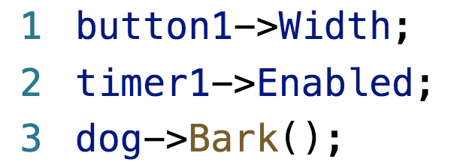
Major difference from C# and Java
All complex objects e.g. buttons, graphics,
user-defined class instances are created
dynamically and managed via pointers
Syntactically, C++ CLI uses -> to access properties
and methods of dynamically created objects
Notes:
C++ allows you to access memory (and objects in memory) in a much more direct way than other languages
This makes it much more powerful and much more dangerous than other languages

Slide 9
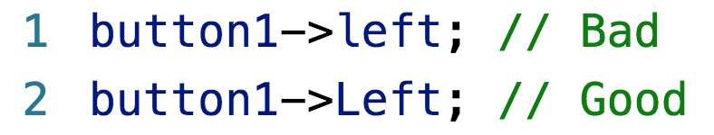
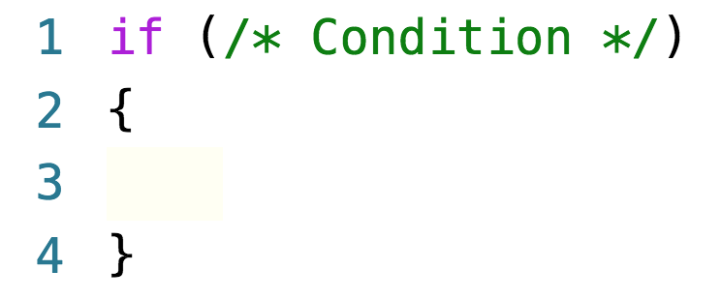
General features of C-family languages
Case sensitive
{} to mark the beginning and end of code blocks
Notes:
All C-family languages are case-sensitive
Be careful about case sensitivity, as the error messages will not help you
All it will say is “left is not a member of class button”, which is confusing when you know full well that buttons have lefts
Note that controls don’t have right and bottom properties so we have to use the assignment operator

Slide 10
Data types
Data Type | Name
Integer | int
Real | float and double
Character | char
Boolean | bool
String | Complex in C++
Notes:
Float and double represent numbers with fractional parts – float 32 bits and double 64 bits

Slide 11
Functions and procedures
All subroutines are functions
Functions that return nothing have return type void
All functions have argument lists
Argument lists maybe empty

Slide 12
Relational operators
Operator | Description
== | Equal to
!= | Not equal to
> | Greater than
< | Less than
>= | Greater than or equal to
<= | Less than or equal to

Slide 13
Arithmetic operators
When using /, C++ automatically performs integer
and real division
Operator | Description
+ | Addition
- | Subtraction
* | Multiplication
/ | Division
% | Modulo
Notes:
Modulo – the “remainder” operation. Frequently used in games programming to generate a looping sequence of numbers from 0 to n-1
Be careful of division, Sometimes, C++ will cast to an int when you really want a float or double
Watch out for funny bugs. When we get to game physics, the language will keep trying to cast your fractions to integers

Slide 14
Arithmetic operators
The ++ and -- operators have different effect
depending on whether they come before or after
i++ – evaluate, then increment
++i – increment, then evaluate
Operator | Description
i++ or ++i | Increments i by one
i-- or --i | Decrements i by one
Notes:
Prefix and postfix operators
a = b++
a = b
b = b + 1
a = ++b
b = b + 1 + 1
a = b

Slide 15
Assignment operators
Operator | Description
= | Assign
+= | Addition and assign
-= | Subtraction and assign
*= | Multiplication and assign
/= | Division and assign
%= | Modulo and assign

Slide 16
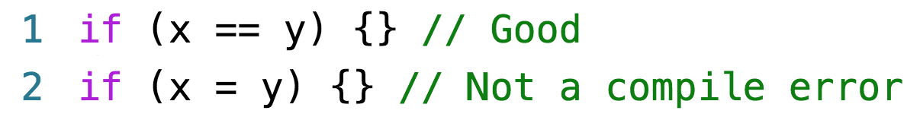
Conditional operators
Caution:
Notes:
Caution: Getting your operator wrong as shown makes for perfectly legal C++. Some IDEs will generate a warning, but will still compile and run

Slide 17
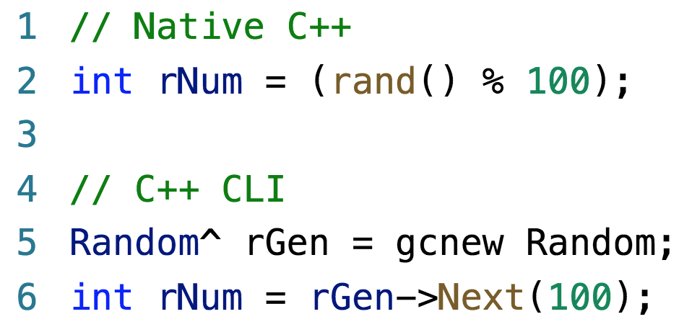
Random number generation
In C++ CLI, create an object of class Random
and call its Next method
Notes:
The native C++ rand() function returns a number between 1 and 32k
Then take the mod of n to get the values between 0 and n-1
This is one of those things that varies from environment to environment. Just always check.

Slide 18
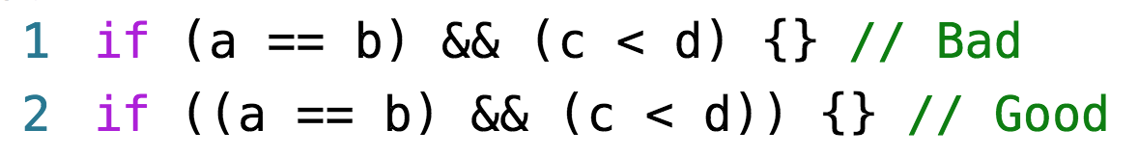
If statements
Use brackets to enforce operator precedence
in complex conditionals
Remember there must be an outer set of parentheses

Slide 19
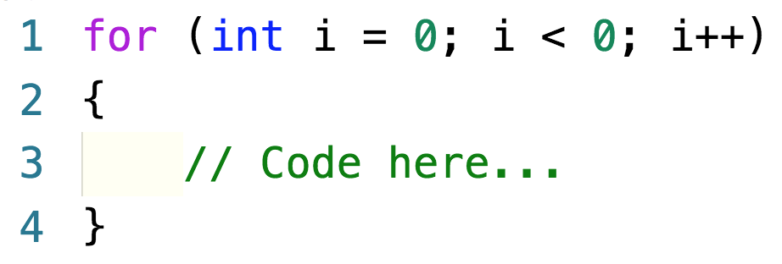
For loops

Slide 20
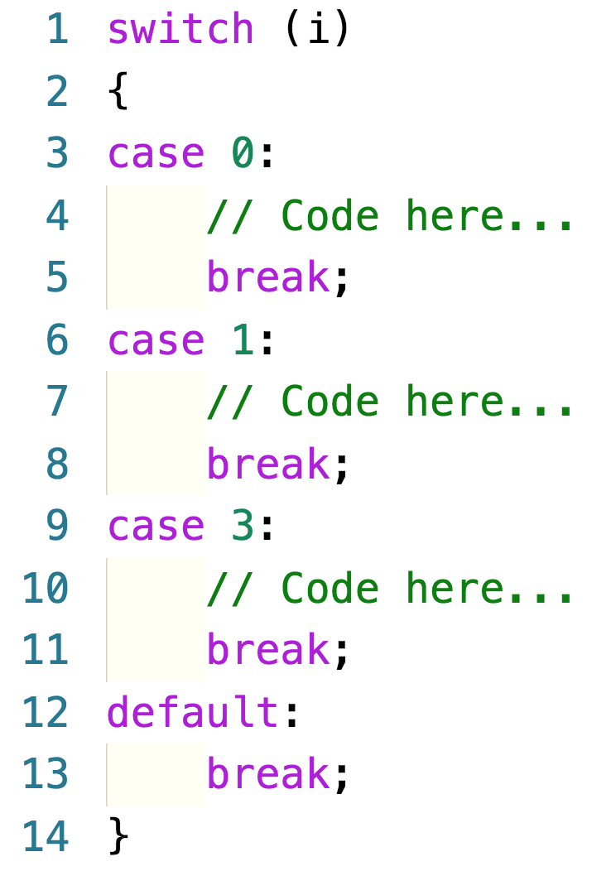
Switch statement
Notes:
Only integers or equivalent can be switched on
Though, if you prefer strings, make an enumerations
Note: Java supports switching on strings but not C/C++

Slide 21
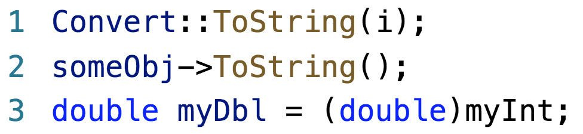
Casting
Notes:
One of the advantages of working in Visual Studio is that you have access to the .NET libraries, which provide many useful and powerful classes
There are dozens of static conversion routines
We’ll talk about static classes more later, but basically this just means you don’t have to declare an instance to use the class methods, you just call them on the class name
Note the :: scoping operator – belongs to the base class object

Slide 22
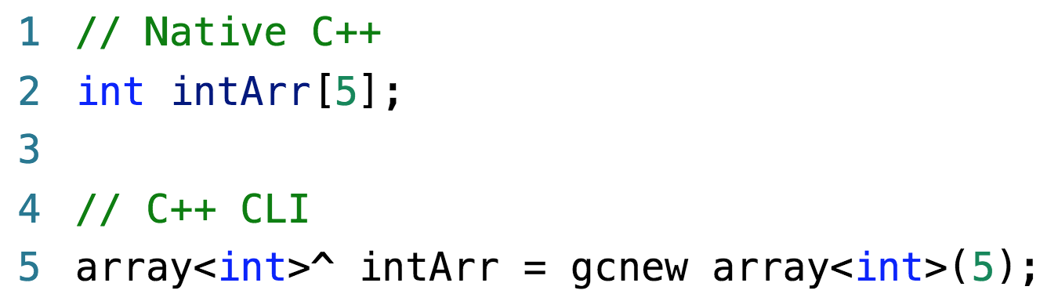
Complex data types – arrays
Visual C++ supports two kinds of arrays:

Slide 23
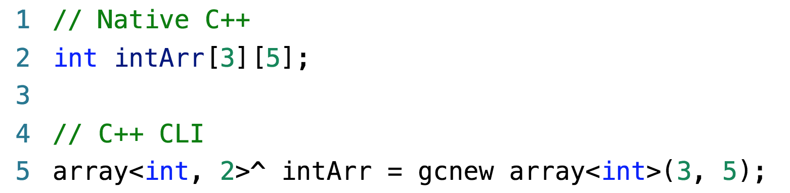
Complex data types – arrays
Visual C++ supports two kinds of multi-dimensional arrays:

Slide 24
Complex data types – records
Called “struct” in Native C++
Deprecated, we will not use them
If we need to hold a mixed collection of data
elements, we will declare a class
Notes:
We will revisit structs/structures in Week 14

Slide 25
Strings
“C has the weakest character string capability
of any general-purpose programming language”
Modern C++ implementations provide string
classes that wrap C’s character arrays to make
them look like strings
We will use String
Requires namespace System

Slide 26
Submitting your code
All assessments excluding exam will be submitted
via GitHub classroom
You will need a GitHub account
Here is the link to GitHub Classroom:
https://classroom.github.com/a/uRzzYdv9
Notes:
Don’t worry, your repository is private and only visible to me and you
I have set code freeze so you won’t be able to push anything to your repository after the due date and time

Slide 27
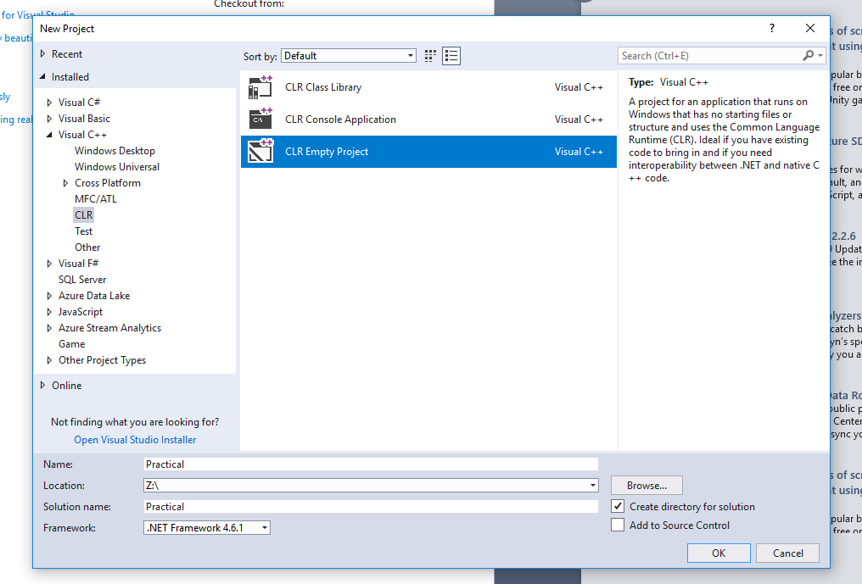
Creating a C++ Windows Form Application
Create a new CLR Empty Project under
Visual C++ -> CLR.
Name your new project “Practical”

Slide 28
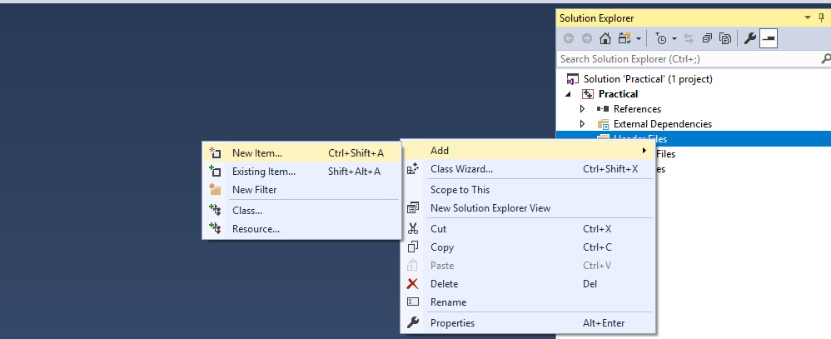
Creating a C++ Windows Form Application
Add a new Item under Header File ->
Add -> New Item

Slide 29
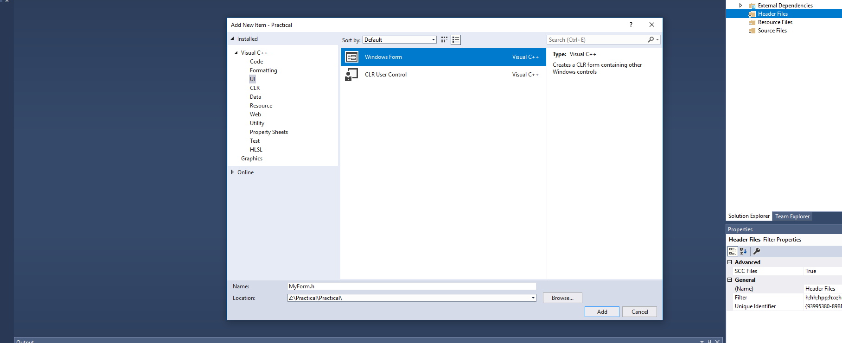
Creating a C++ Windows Form Application
Add a new Windows Form under UI

Slide 30
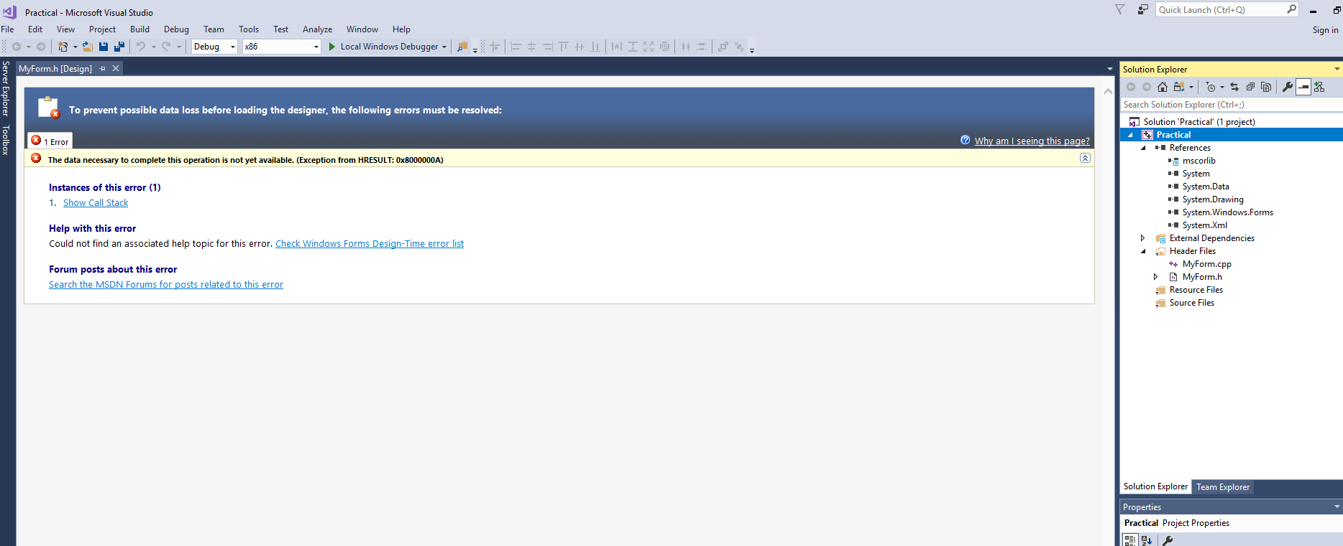
Creating a C++ Windows Form Application
A new Windows Form .h and .cpp has been created

Slide 31
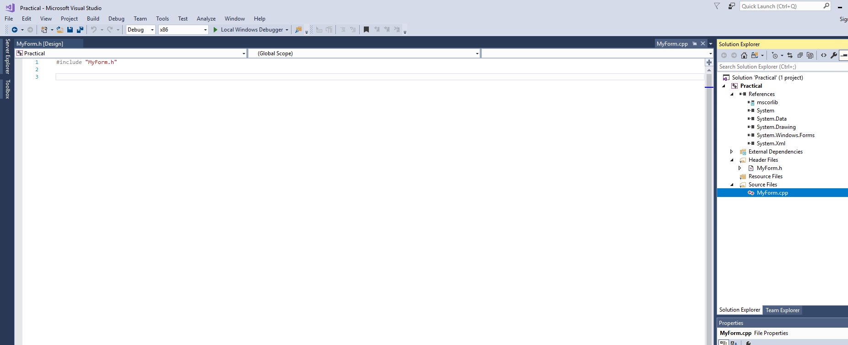
Creating a C++ Windows Form Application
Drag MyForm.cpp to the Source Files directory

Slide 32
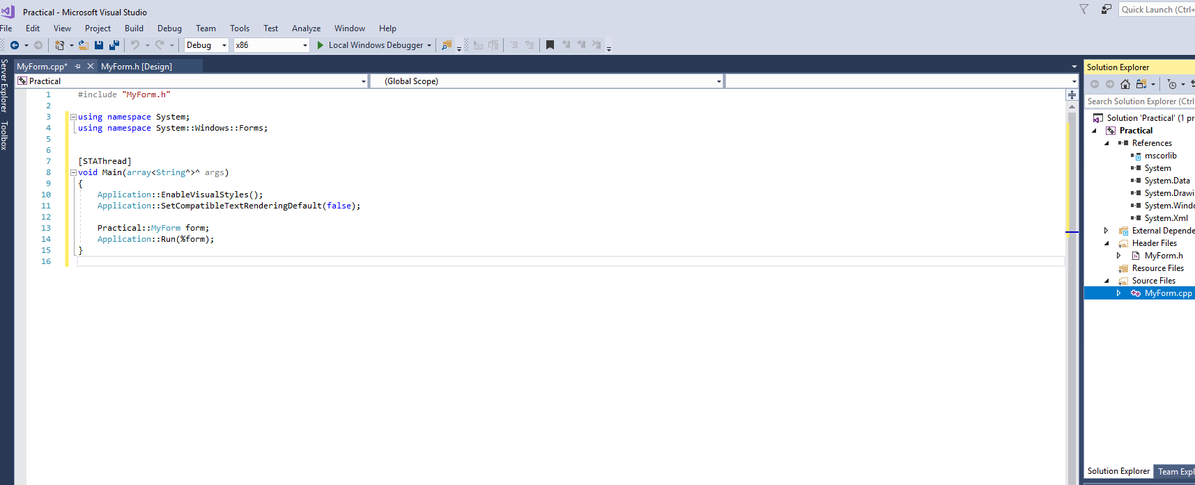
Creating a C++ Windows Form Application
Write the following lines of code into
your MyForm.h

Slide 33
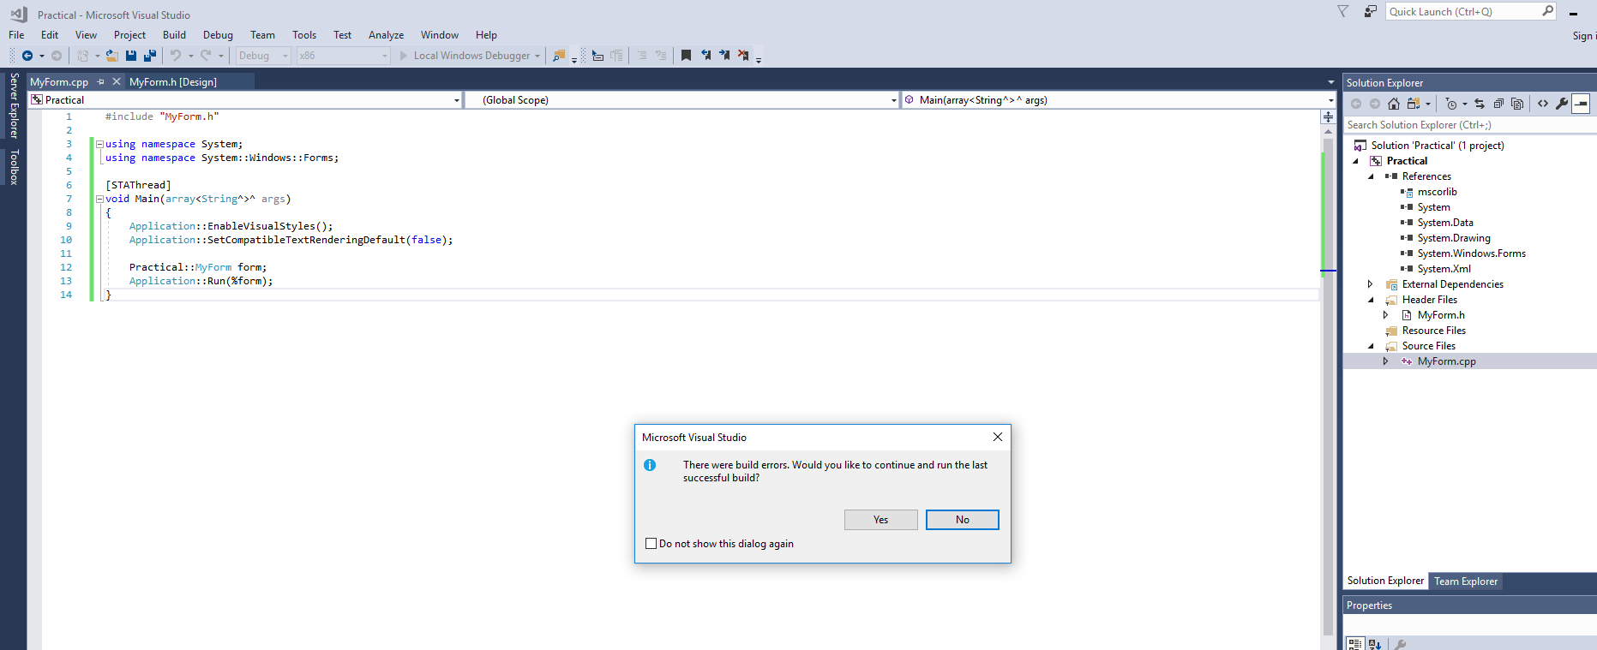
Creating a C++ Windows Form Application
When you run the project, you should get
the following error “entry point must be defined”

Slide 34
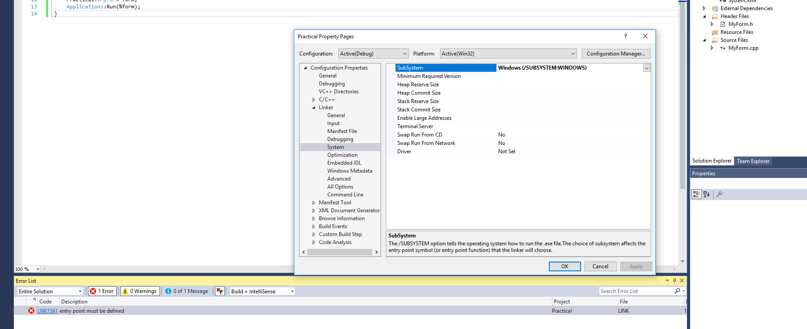
Creating a C++ Windows Form Application
Go to the project’s Properties
Click Linker -> System and change the SubSystem
to the following

Slide 35
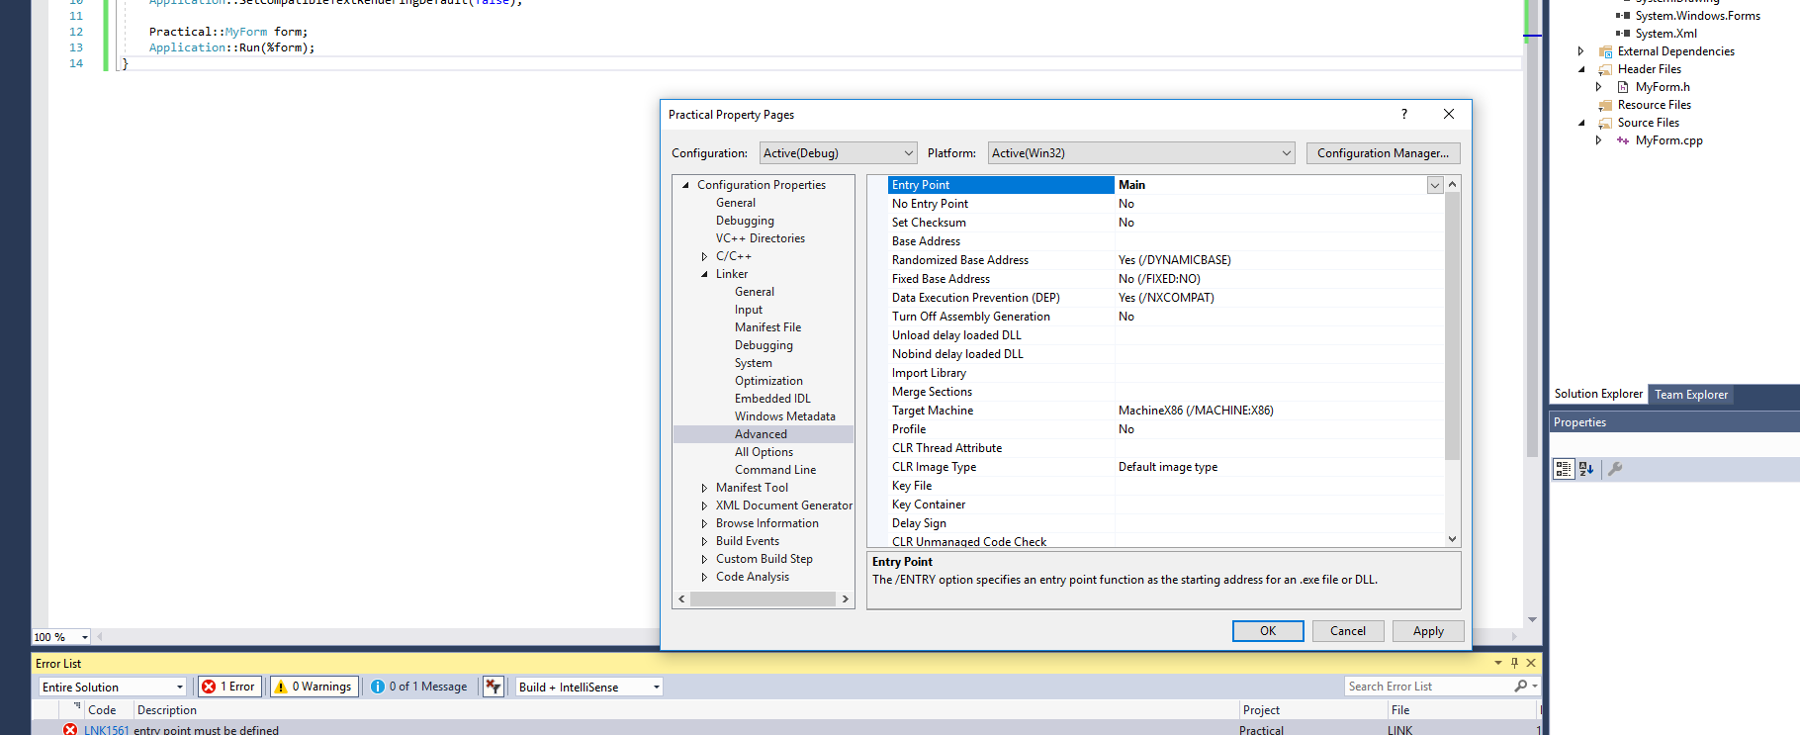
Creating a C++ Windows Form Application
Go to the project’s Properties
Click Linker -> Advanced and change the Entry
Point to the following

Slide 36
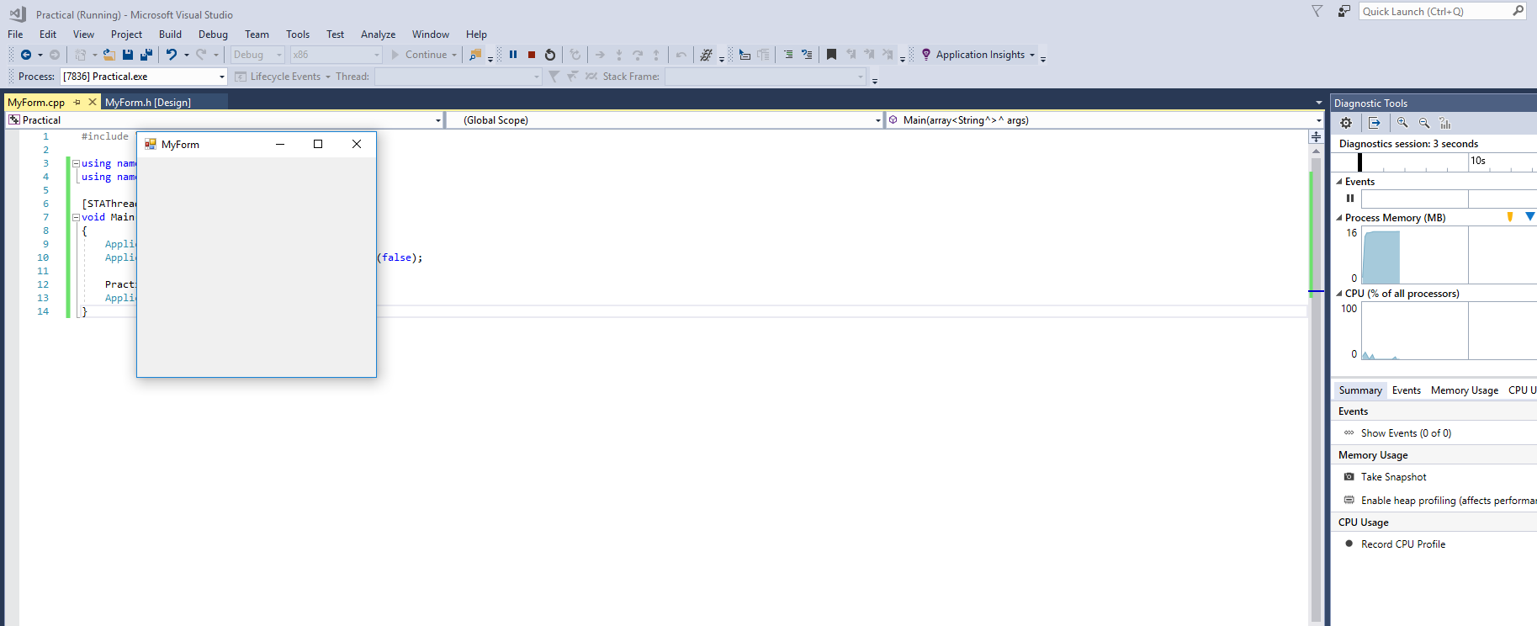
Creating a C++ Windows Form Application
Now you can run your application without
compilation errors. An empty form should display

